Slide 1
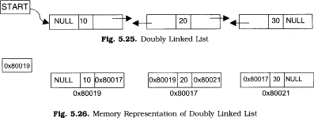
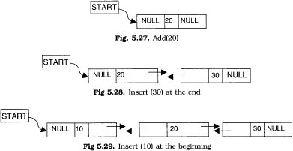
Lec.2
DOUBLY LINKED LIST
A doubly linked list is one in which all nodes are linked together by multiple links which help in accessing both the successor (next) and predecessor (previous) node for any arbitrary node within the list. Every nodes in the doubly linked list has three fields: LeftPointer, RightPointer and DATA. Fig. 5.22 shows a typical doubly linked list.
LPoint will point to the node in the left side (or previous node) that is LPoint will hold the address of the previous node. RPoint will point to the node in the right side (or nex node) that is RPoint will hold the address of the next node. DATA will store the information of the node.
Representation of doubly linked list
A node in the doubly linked list can be represented in memory with the following declarations. Struct Node
{
Int DATA;
Node *next; Node *prev;
};
All the operations performed on singly linked list can also be performed on doubly linked list. Following figure will illustrate the insertion and deletion of nodes.

Slide 2
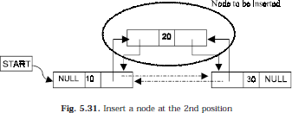
Algorithm for creating a doubly linked list (inserting at the end)
Input the DATA to be inserted
TEMP to create a new node
TEMP->info=DATA
TEMP->next=NULL
if (START is equal to NULL)
TEMP->prev=NULL
START=TEMP
exit
else
HOLD =START
while(HOLD->next not equal to NULL)
6.b.1 HOLD=HOLD->next
HOLD->next=TEMP
TEMP->prev=HOLD
exit
Algorithm for inserting a node at the beginning
Input the DATA to be inserted
TEMP to create a new node
TEMP->prev=NULL
TEMP->info=DATA
TEMP->next=START
if (START is equal to NUUl)
START=TEMP
exit
START->prev=TEMP
START=TEMP
exit
Lec.2
Algorithm for inserting a node at a specific position
Suppose START is the first position in linked list. Let DATA be the element to be inserted in the new node. POS is the position where the NewNode is to be inserted. TEMP is a temporary pointer to hold the node address.
Input the DATA and POS
Initialize TEMP = START; i = 0

Slide 3
Repeat the step 4 if (i less than POS) and (TEMP is not equal to NULL)
TEMP = TEMP ->next; i = i +1
If (TEMP not equal to NULL) and (i equal to POS)
Create a New Node
NewNode -> DATA = DATA
NewNode -> next = TEMP -> next
NewNode -> prev = TEMP
(TEMP -> next) -> prev = NewNode (f ) TEMP -> next = New Node
Else
Display “Position NOT found”
Exit
Algorithm for deleting a node
Lec.2
Suppose START is the address of the first node in the linked list. Let DATA be the Element to be deleted. TEMP, HOLD is the temporary pointer to hold the address of the node.
Input the DATA to be deleted
if ((START->DATA)is equal to DATA)
TEMP = START
START = STAR->next
START->prev=NULL
set free the node TEMP , which is deleted
Exit
HOLD = START
while((HOLD->next->next) not equal to NULL) (a)if (HOLD->next->DATA) equal to DATA)
(a1) TEMP = HOLD->next
(a2)HOLD->next=TEMP->next (a3) TEMP->next->prev=HOLD
(a4) set free the node TEMP, which is deleted
(a5) Exit
(b) HOLD=HOLD->next
if ((HOLD->next->DATA)==DATA)
TEMP=HOLD->next
set free the node TEMP, which is deleted
HOLD->next=NULL
exit
Display “DATA not found”

Slide 4
7.Exit
Algorithm for displaying the doubly linked list
if (START is equal to NULL)
display “The list is empty”
exit
TEMP=START
while TEMP is not equal to NULL
display TEMP->info
TEMP=TEMP->next
exit
Assignment
write an algorithm and a function to display a doubly linked list in reverse order.
write an algorithm and a function to count the number of elements in the doubly linked list.
write an algorithm and function for searching a number in doubly linked list.
Lec.2

